Slide 1

systems design phase
The purpose of the Design Phase is to transform the requirements into complete and detailed system design specifications. Once the design is approved, the Development Team begins the Development Phase..

Slide 2
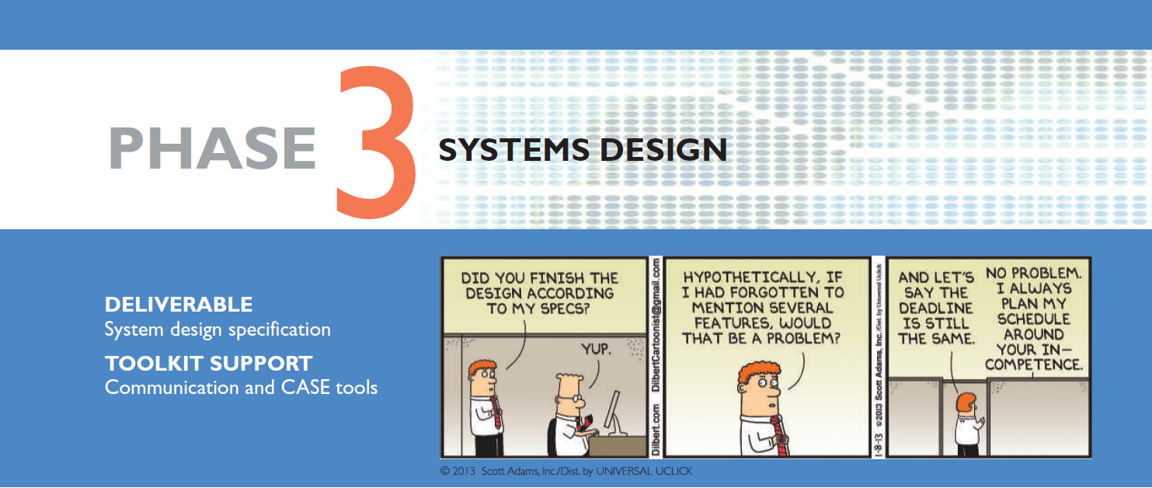
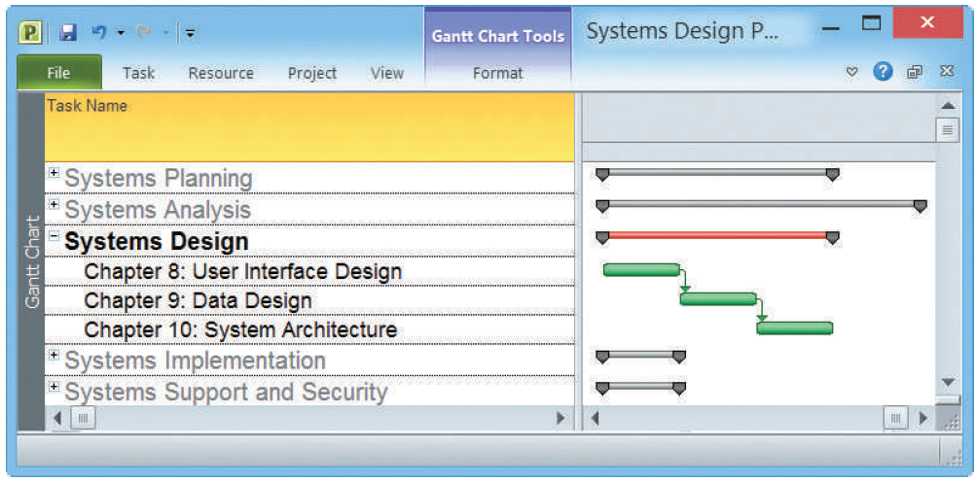

Systems Analysis and Design, 10th Edition
Scott Tilley and Harry Rosenblatt

Slide 3
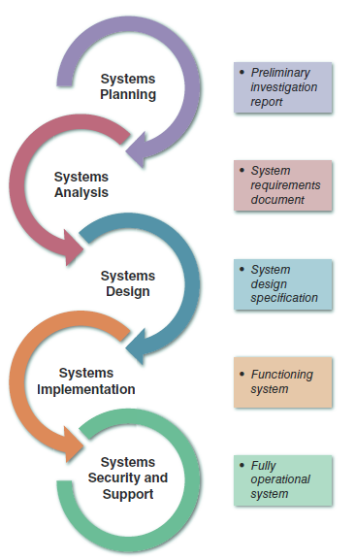
Systems design is the third of five phases in the systems development life cycle.
In the previous phase, systems analysis, a logical model of the new system was developed.
The output of that phase, the system requirements document, is used as input to the system design phase, where a physical design is created that satisfies the system requirements.

Slide 4
Systems Analysis and Design 10th Edition
Chapter 9 – Data Design
focuses on the data design skills that are necessary for a systems analyst to construct the physical model of the information system

Slide 5
Chapter Objectives
Explain file-oriented systems and how they differ from database management systems
Explain data design terminology, including entities, fields, common fields, records, files, tables, and key fields
Describe data relationships, draw an entity relationship diagram, define cardinality, and use cardinality notation
Explain the concept of normalization
Explain the importance of codes and describe various coding schemes
Explain data warehousing and data mining
Differentiate between logical and physical storage and records
Explain data control measures

Slide 6
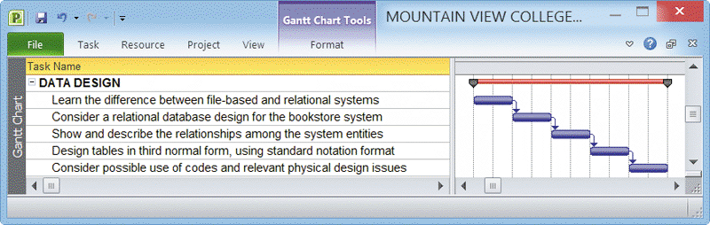
Data Design Concepts
Data Structures
  A framework for organizing, storing, and managing data
  Consists of files or tables that interact in various ways
    Each file or table contains data about people, places, things, or events
FIGURE 9-1 Typical data design task list

Slide 7

Data Design Concepts (Cont.)
Mario and Danica: A Data Design Example
  Mario’s Auto Shop
    Mario relies on two file oriented systems, that
    store data in separate files that are not connected
    The MECHANIC SYSTEM uses the MECHANIC file to store data about shop employees
    The JOB SYSTEM uses the JOB file to store data
    about work performed at the shop
  Danica’s Auto Shop
    Uses a database management system (DBMS) with two separate tables that are joined, so they act like one large table
    In Danica’s SHOP OPERATIONS SYSTEM, the tables are linked by the Mechanic No field, which is called a common field because it connects the tables
FIGURE 9-2 In the example shown here, data about the mechanic, the customer, and the brake job might be stored in a file-oriented system or in a database system

Slide 8
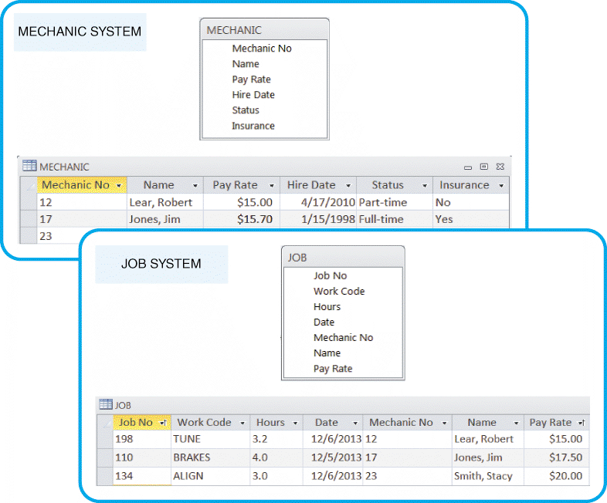
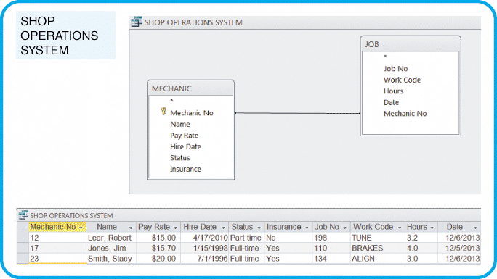
Data Design Concepts (Cont.)
Mario’s Auto Shop
Danica’s Auto Shop
FIGURE 9-4 Danica’s SHOP OPERATIONS SYSTEM uses a database design, which avoids duplication. The data can be viewed as if it were one large table, regardless of where the data is stored physically
FIGURE 9-3 Mario’s shop uses two separate systems, so certain data must be entered twice. This redundancy is inefficient, and can produce data errors

Slide 9
Data Design Concepts (Cont.)
Is File Processing Still Important?
  Handles large volumes of structured data on a regular basis
  Can be cost-effective
  Great for transaction processing
The Database Environment
  A database management system (DBMS) is a collection of tools, features, and interfaces that enables users to add, update, manage, access, and analyze data

Slide 10
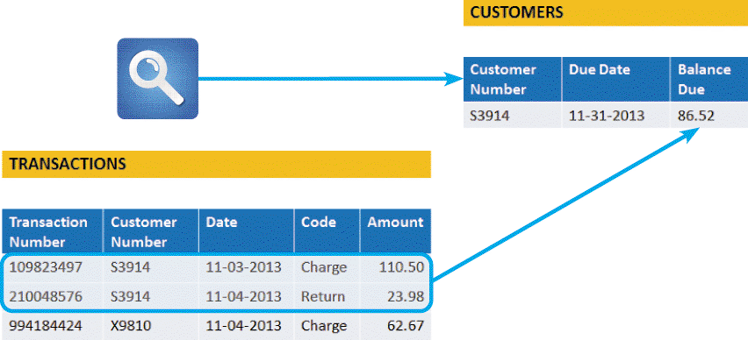
Data Design Concepts (Cont.)
FIGURE 9-5 A credit card company that posts thousands of daily transactions might consider a file processing option

Slide 11
Data Design Concepts (Cont.)
DBMS Advantages
  Scalability - A system can be expanded, modified, or downsized
  Economy of scale - Database design allows better utilization of hardware
  Enterprise-wide application - A database administrator (DBA) assesses overall requirements and maintains the database for the entire
  Stronger standards - Standards for data names, formats, and documentation are followed uniformly throughout the organization

Slide 12
Data Design Concepts (Cont.)
DBMS Advantages
  Better security - The DBA ensures that only legitimate users access the database and different users have different levels of access
  Data independence - Systems that interact with a DBMS are relatively independent of how the physical data is maintained
    That design provides the DBA flexibility to alter data structures without modifying information systems that use the data

Slide 13
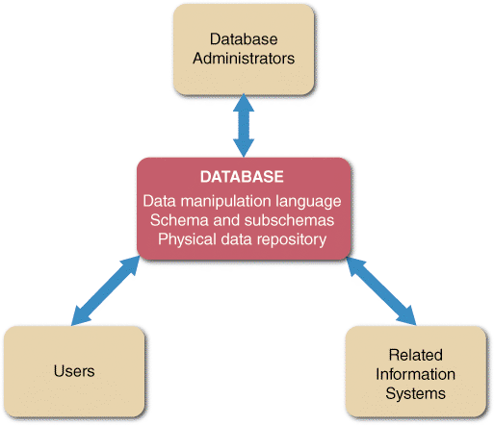
DBMS Components
Interfaces for Users, Database Administrators, and Related Systems
  USERS
    Typically work with predefined queries and switchboard commands, but also use query languages to access stored data
  DATABASE ADMINISTRATORS
    Concerned with data security and integrity, preventing unauthorized access, providing backup and recovery, audit trails, maintaining the database, and supporting user needs
  RELATED INFORMATION SYSTEMS
    A DBMS can support several related information systems that provide input to, and require specific data from, the DBMS
FIGURE 9-7 In addition to interfaces for users, database administrators, and related information systems, a DBMS also has a data manipulation language, a schema and subschemas, and a physical data repository

Slide 14
DBMS Components (Cont.)
Data Manipulation Language
  A data manipulation language (DML) controls database operations, including storing, retrieving, updating, and deleting data
Schema
  The complete definition of a database, including descriptions of all fields, tables, and relationships, is called a schema
Physical Data Repository
  is a structured storage system designed to securely hold large amounts of data in a physical form.
  This could include databases housed on physical servers, hard drives, tapes, or other hardware-based storage solutions.

Slide 15
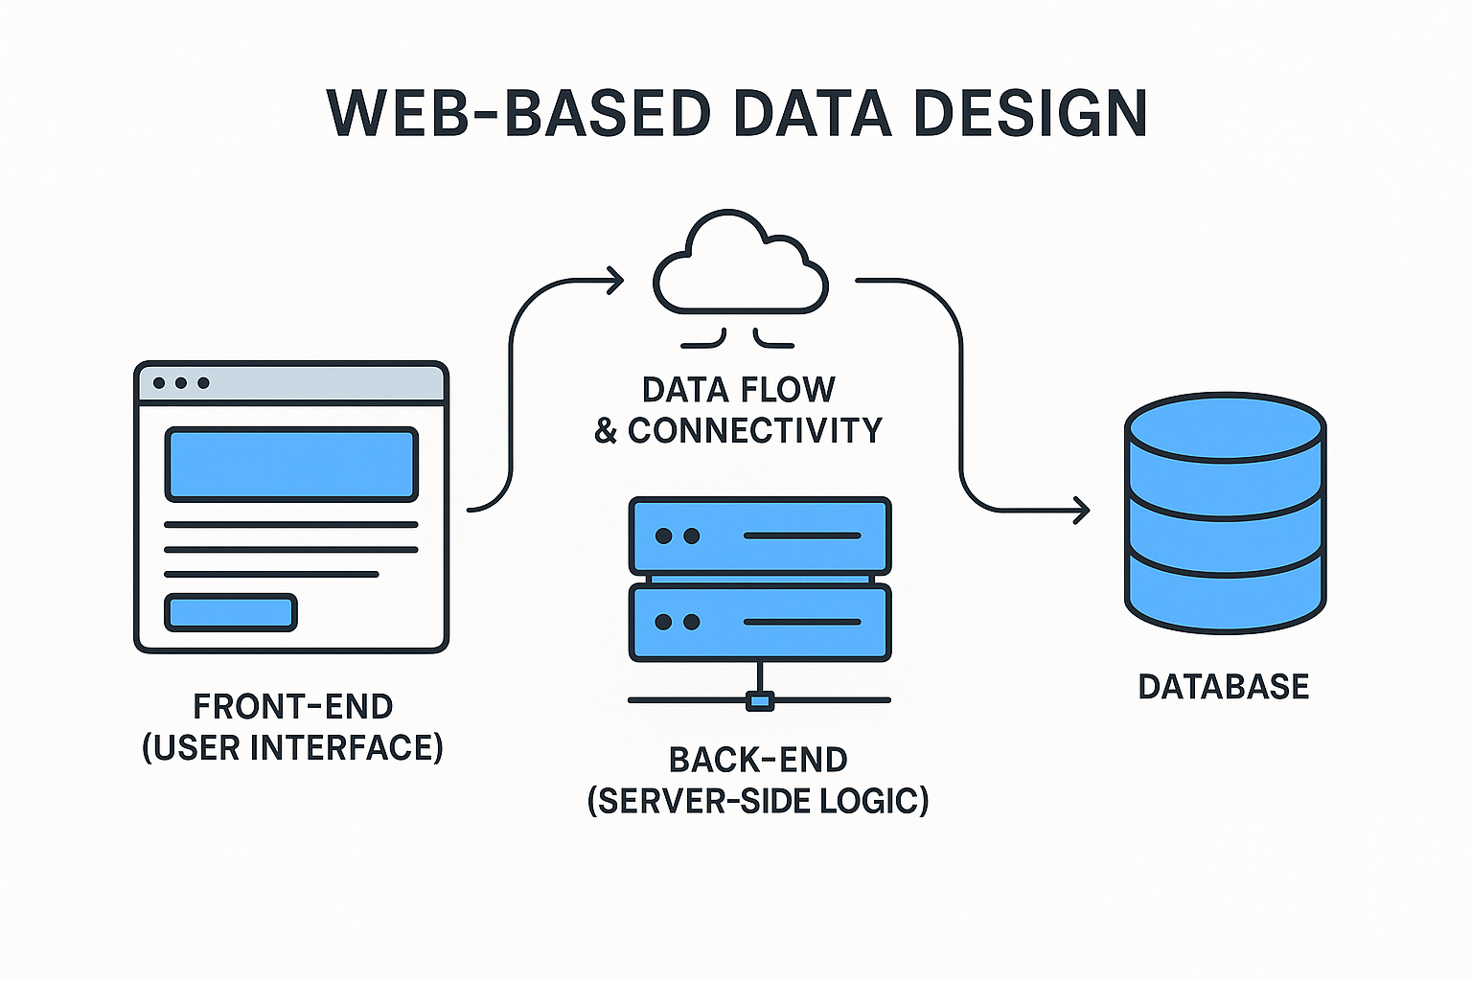
Web-Based Data Design
Web-Based Data Design refers to the planning and structuring of how data is collected, stored, managed, and accessed through a web-based application or system.

Slide 16
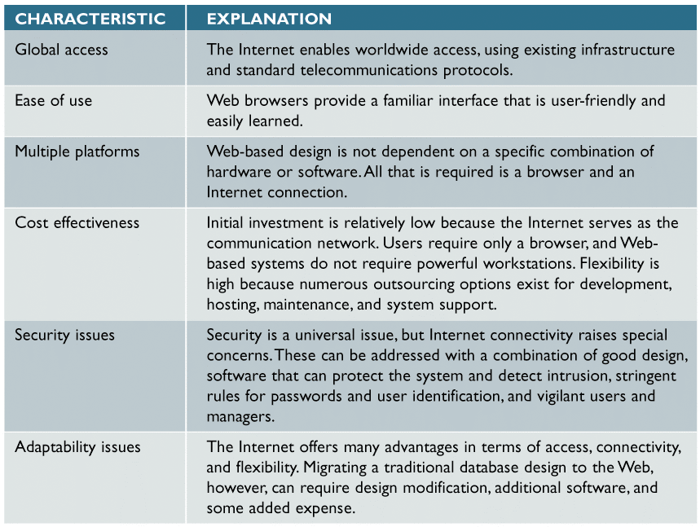
Web-Based Data Design (Cont.)
FIGURE 9-9 A Web-based design characteristics include global access, ease of use, multiple platforms, cost effectiveness, security issues, and adaptability issues. In a Web-based design, the Internet serves as the front end, or interface, for the database management system. Access to the database requires only a Web browser and an Internet connection

Slide 17
Data Design Terms
Definitions:
  ENTITY
    An entity is a person, place, thing, or event for which data is collected and maintained
  TABLE OR FILE
    A table, or file, contains a set of related records that store data about a specific entity
  FIELD
    A field, also called an attribute, is a single characteristic or fact about an entity
  RECORD
    A record, also called a tuple (rhymes with couple), is a set of related fields that describes one instance, or occurrence, of an entity, such as one customer, one order, or one product

Slide 18
Data Design Terms (Cont.)
Key Fields:
  PRIMARY KEY
    A field or combination of fields that uniquely and minimally identifies a particular member of an entity
  CANDIDATE KEY
    Any field that could serve as a primary key is called a candidate key
  FOREIGN KEY
    A common field that exists in more than one table and can be used to form a relationship, or link, between the tables
  SECONDARY KEY
    A field or combination of fields that can be used to access or retrieve records

Slide 19
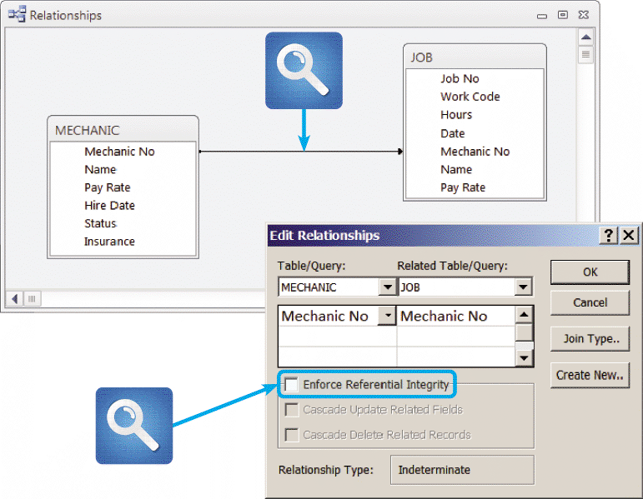
Data Design Terms (Cont.)
Referential Integrity:
  A set of rules that avoids data inconsistency and quality problems. In a relational database, referential integrity means that a foreign key value cannot be entered in one table unless it matches an existing primary key in another table
FIGURE 9-13 Microsoft Access allows a user to specify that referential integrity rules will be enforced in a relational database design

Slide 20
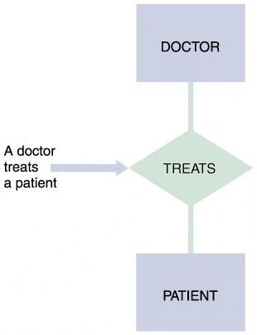
Entity-Relationship Diagrams
Drawing an ERD
  The first step is to list the entities that you identified during the systems analysis phase and to consider the nature of the relationships that link them
Types of Relationships
  Three types of relationships can
  exist between entities:
    One-to-one
    One-to-many
    Many-to-many
FIGURE 9-14 In an entity-relationship diagram, entities are labeled with singular nouns and relationships are labeled with verbs. The relationship is interpreted as a simple English sentence.

Slide 21
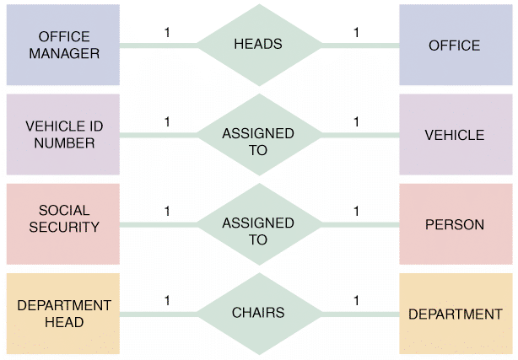
Entity-Relationship Diagrams (Cont.)
A one-to-one relationship, abbreviated 1:1, exists when exactly one of the second entity occurs for each instance of the first entity
Figure 9-15 shows examples of several 1:1 relationships
A number 1 is placed alongside each of the two connecting lines to indicate the 1:1 relationship
FIGURE 9-15 Examples of one-to-one (1:1) relationships

Slide 22
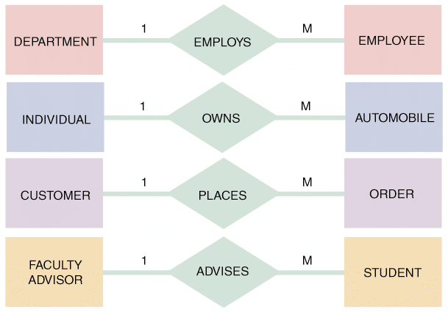
Entity-Relationship Diagrams (Cont.)
A one-to-many relationship, abbreviated 1:M, exists when one occurrence of the first entity can relate to many instances of the second entity, but each instance of the second entity can associate with only one instance of the first entity
FIGURE 9-16 Examples of one-to-many (1:M) relationships

Slide 23
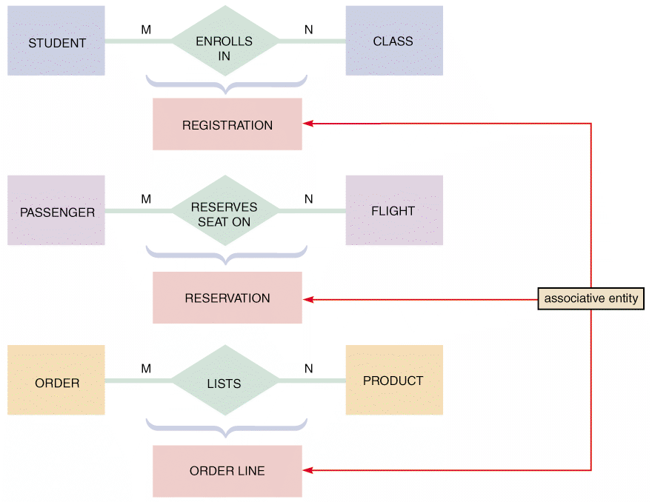
Entity-Relationship Diagrams (Cont.)
A many-to-many relationship, abbreviated M:N, exists when one instance of the first entity can relate to many instances of the second entity, and one instance of the second entity can relate to many instances of the first entity
FIGURE 9-17 Examples of many-to-many (M:N) relationships. Notice that the event or transaction that links the two entities is an associative entity with its own set of attributes and characteristics

Slide 24
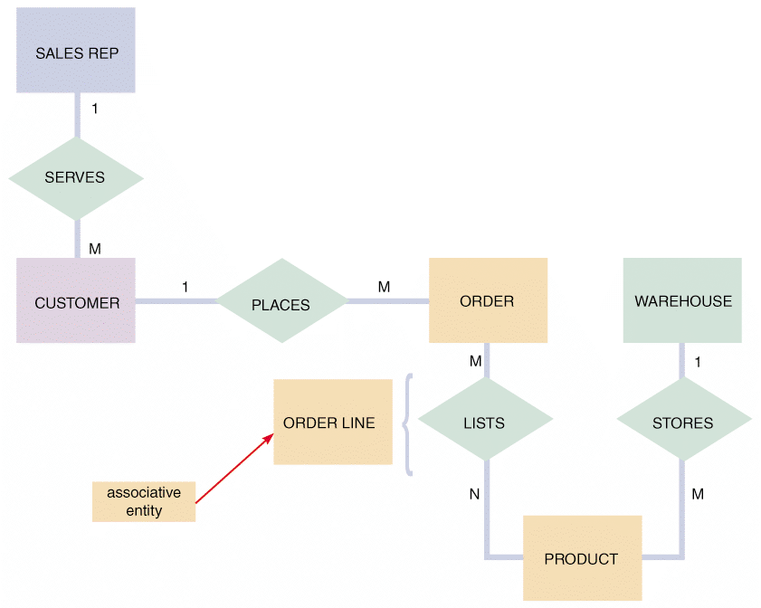
Entity-Relationship Diagrams (Cont.)
FIGURE 9-18 An entity-relationship diagram for SALES REP, CUSTOMER, ORDER, PRODUCT, and WAREHOUSE. Notice that the ORDER and PRODUCT entities are joined by an associative entity named ORDER LINE

Slide 25
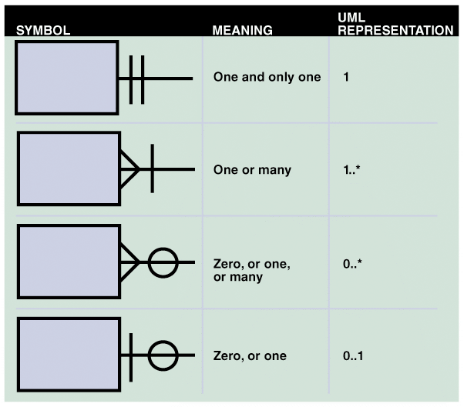
Entity-Relationship Diagrams (Cont.)
Cardinality
  Describes the numeric
  relationship between
  two entities and shows
  how instances of one
  entity relate to instances
  of another entity
  A common method of
  cardinality notation is
  called crow’s foot
  notation because of the
  shapes, which include
  circles, bars, and symbols,
  that indicate various possibilities
FIGURE 9-19 Crow’s foot notation is a common method of indicating cardinality. The four examples show how you can use various symbols to describe the relationships between entities

Slide 26
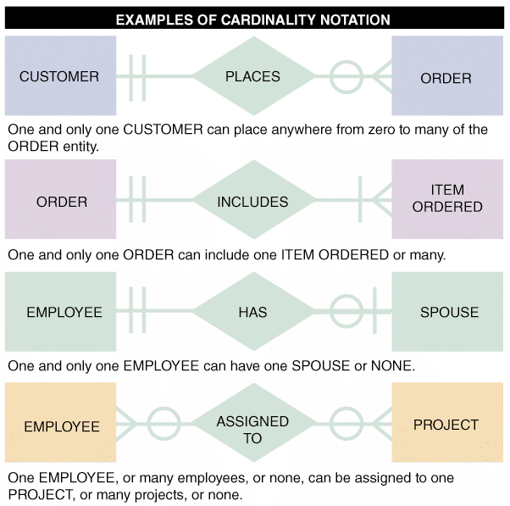
Entity-Relationship Diagrams (Cont.)
FIGURE 9-20 In the first example of cardinality notation, one and only one
CUSTOMER can place anywhere from zero to many of the ORDER entity.
In the second example, one and only one ORDER can include one ITEM ORDERED or many.
In the third example, one and only one EMPLOYEE can have one SPOUSE or none. In the fourth example, one EMPLOYEE, or many employees, or none, can be assigned to one PROJECT, or many projects, or none

Slide 27
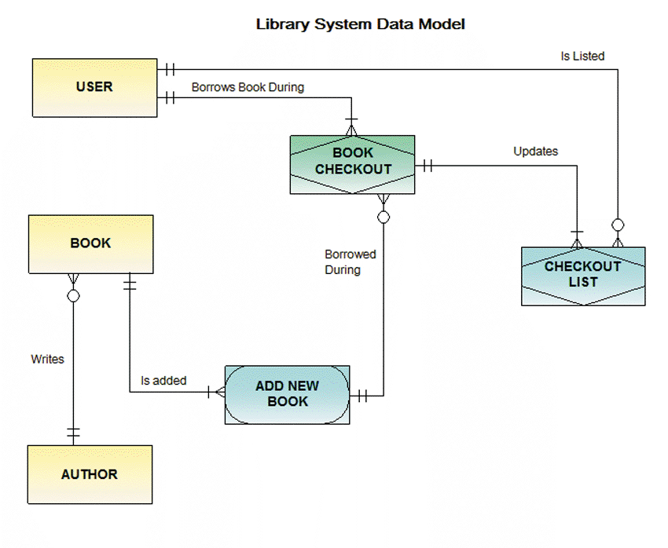
Entity-Relationship Diagrams (Cont.)
FIGURE 9-21 An ERD for a library system drawn with Visible Analyst. Notice
that crow’s foot notation has been used and relationships are described in both
directions

Slide 28
Data Normalization

Slide 29
Data Normalization
Normalization is the process of creating table designs by assigning specific fields or attributes to each table in the database
Normalization involves applying a set of rules that can help you identify and correct inherent problems and complexities in your table designs
The normalization process typically involves four stages:
  Unnormalized design
  First normal form
  Second normal form
  Third normal form

Slide 30
Data Normalization (Cont.)
Standard Notation Format
  Starts with the name of the table, followed by a parenthetical expression that contains the field names separated by commas. The primary key field(s) is underlined, like this:
    NAME (FIELD 1, FIELD 2, FIELD 3)
  A repeating group is a set of one or more fields that can occur any number of times in a single record, with each occurrence having different values

Slide 31
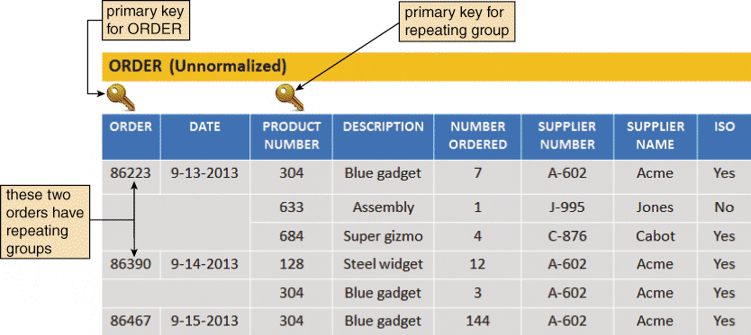
Data Normalization (Cont.)
FIGURE 9-22 In the ORDER table design, two orders have repeating groups that contain several products. ORDER is the primary key for the ORDER table, and PRODUCT NUMBER serves as a primary key for the repeating group. Because it contains repeating groups, the ORDER table is unnormalized

Slide 32
Data Normalization (Cont.)
First Normal Form (1NF)
  A table is in first normal form (1NF) if it does not contain a repeating group
  When you eliminate the repeating group, additional records emerge — one for each combination of a specific order and a specific product
    The result is more records, but a greatly simplified design

Slide 33
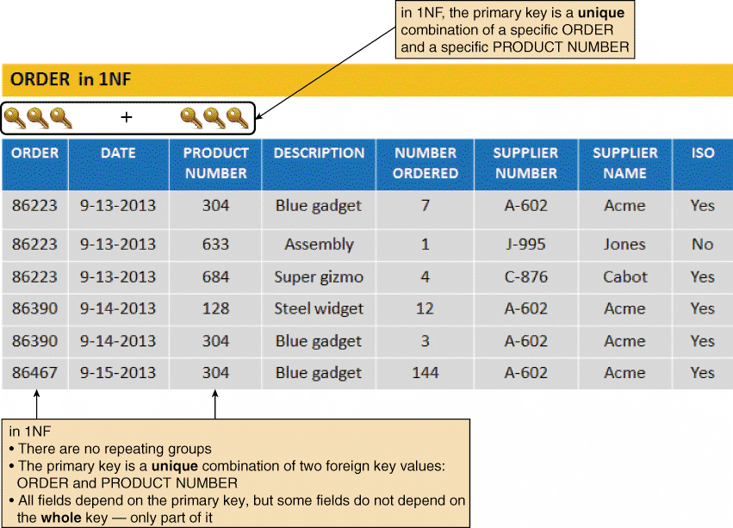
Data Normalization (Cont.)
FIGURE 9-23 The ORDER table as it appears in 1NF. The repeating groups have been eliminated. Notice that the repeating group for order 86223 has become three separate records, and the repeating group for order 86390 has become two separate records. The 1NF primary key is a combination of ORDER and PRODUCT NUMBER, which uniquely identifies each record

Slide 34
Data Normalization (Cont.)
Second Normal Form (2NF)
  Must understand the concept of functional Dependence
    Field A is functionally dependent on Field B if the value of Field A depends on Field B
    A DATE value is functionally dependent on an ORDER, because for a specific order number, there can be only one date
    Objective is to break the original table into two or more new tables and reassign the fields so that each non-key field will depend on the entire primary key in its table

Slide 35
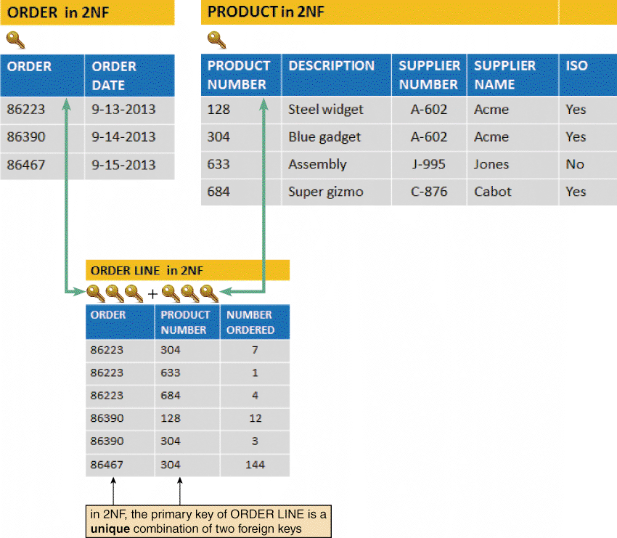
Data Normalization (Cont.)
FIGURE 9-24 ORDER, PRODUCT, and ORDER LINE tables in 2NF. All fields are functionally dependent on
the primary key

Slide 36
Data Normalization (Cont.)
Third Normal Form (3NF)
  A design is in 3NF if every non-key field depends on the key, the whole key, and nothing but the key
  A 3NF design avoids redundancy and data integrity problems that still can exist in 2NF designs
  To convert the table to 3NF, you must remove all fields from the 2NF table that depend on another non-key field and place them in a new table that uses the non-key field as a primary key

Slide 37
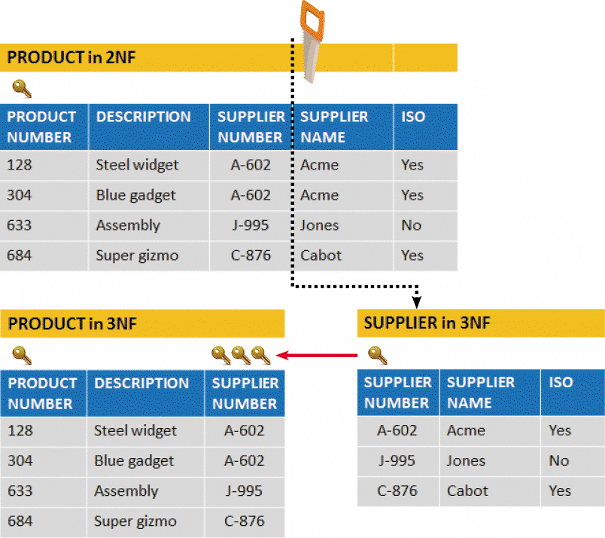
Data Normalization (Cont.)
FIGURE 9-25 When the PRODUCT table is transformed from 2NF to 3F, the result is two separate tables:
PRODUCT and SUPPLIER. Note that in 3NF, all fields depend on the key, the whole key, and nothing but the key!

Slide 38
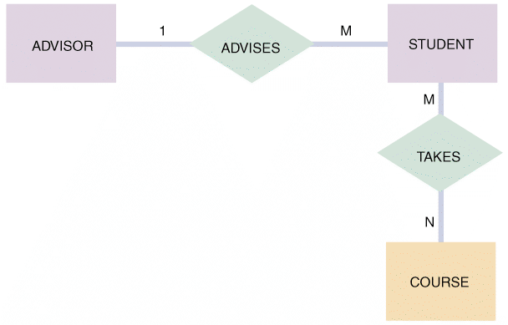
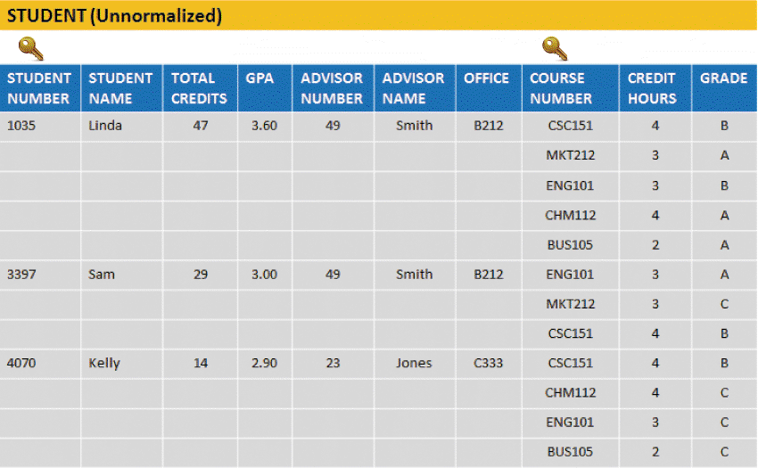
Two Real-World Examples
Example 1: Crossroads College
FIGURE 9-27 An initial entity-relationship diagram for ADVISOR,
STUDENT, and COURSE
FIGURE 9-28 The STUDENT table is unnormalized because it contains a repeating group that represents the courses each student has taken

Slide 39
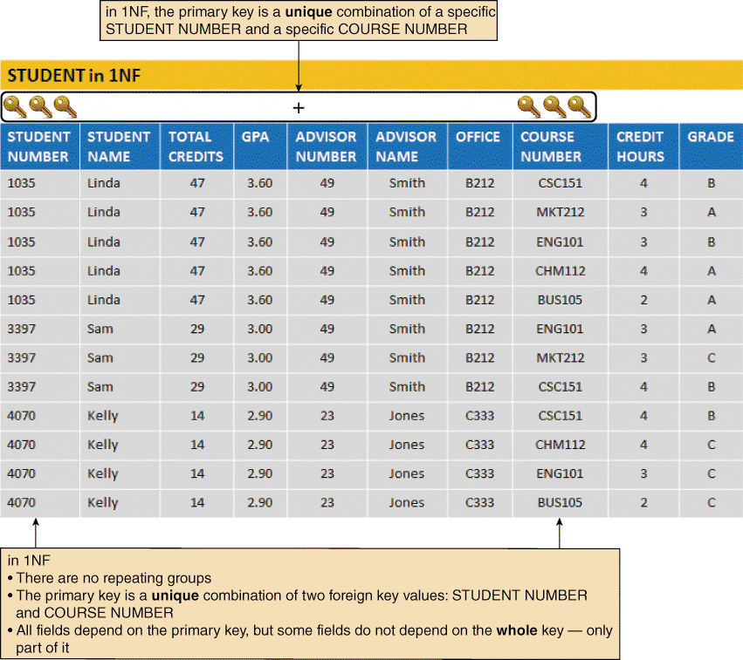
Two Real-World Examples (Cont.)
FIGURE 9-29 The STUDENT table in 1NF. Notice that the primary key has been expanded to include STUDENT NUMBER and COURSE NUMBER

Slide 40
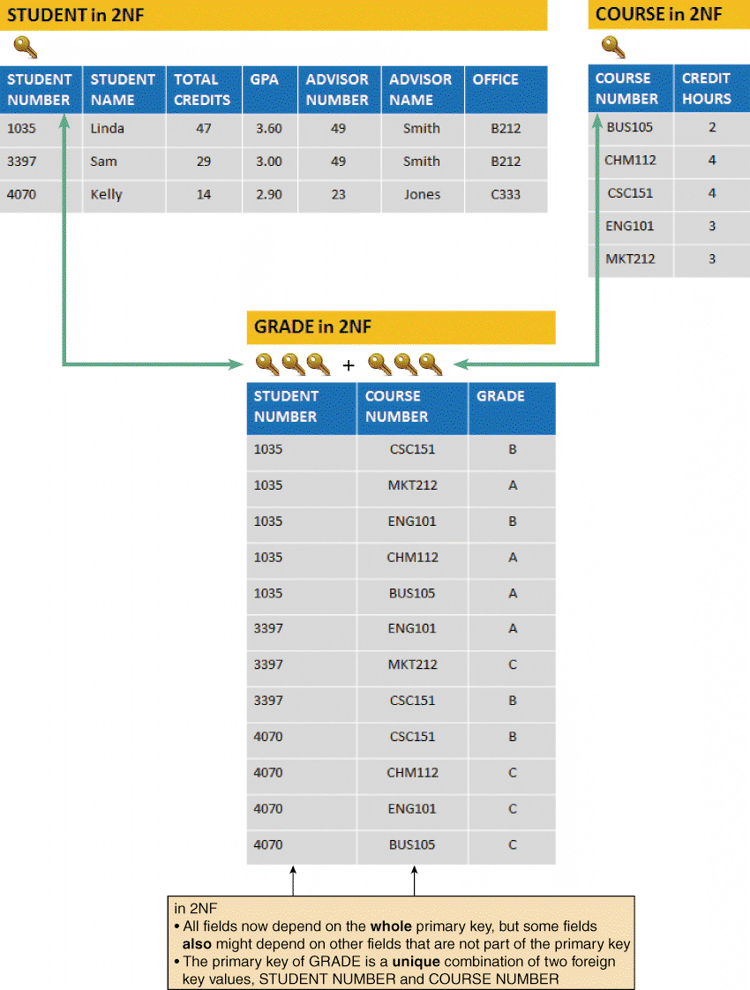
Two Real-World Examples (Cont.)
FIGURE 9-30 The STUDENT, COURSE, and GRADE tables in 2NF. Notice that all fields are functionally dependent on the entire primary key of their respective tables

Slide 41
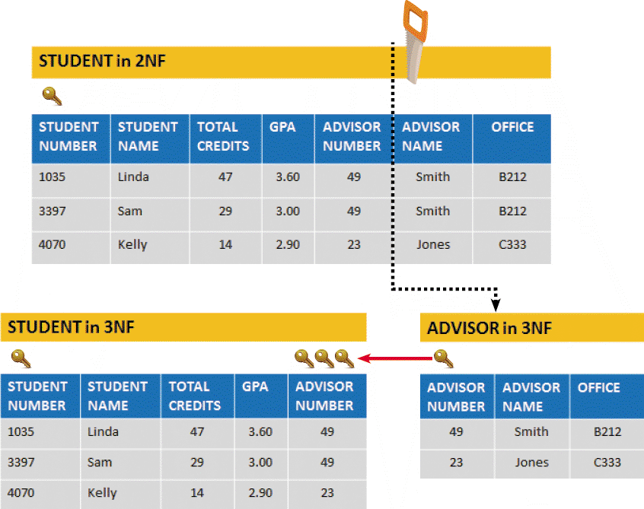
Two Real-World Examples (Cont.)
FIGURE 9-31 STUDENT, ADVISOR, COURSE, and GRADE tables in 3NF. When the STUDENT table is
transformed from 2NF to 3NF, the result is two tables: STUDENT and ADVISOR

Slide 42
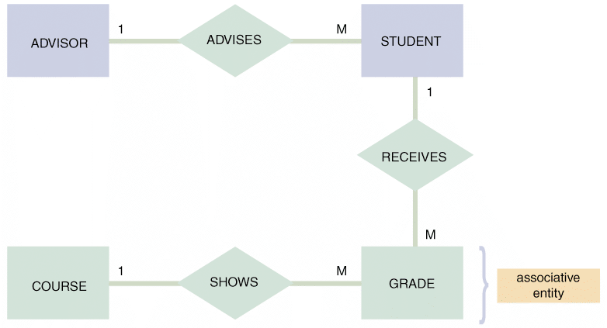
Two Real-World Examples (Cont.)
FIGURE 9-32 The entity-relationship diagram for STUDENT, ADVISOR, and COURSE after normalization. The GRADE entity was identified during the normalization process. GRADE is an associative entity that links the STUDENT and COURSE tables

Slide 43
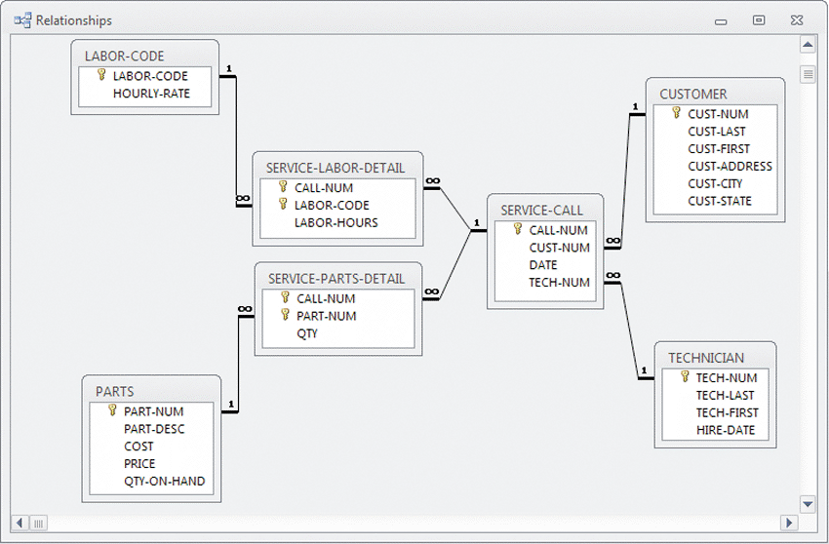
Two Real-World Examples (Cont.)
Example 2: Magic Maintenance
FIGURE 9-33 A relational database design for a computer service company uses common fields to link the tables and form an overall data structure. Notice the one-to-many notation symbols, and the primary keys, which are indicated with gold-colored key symbols

Slide 44
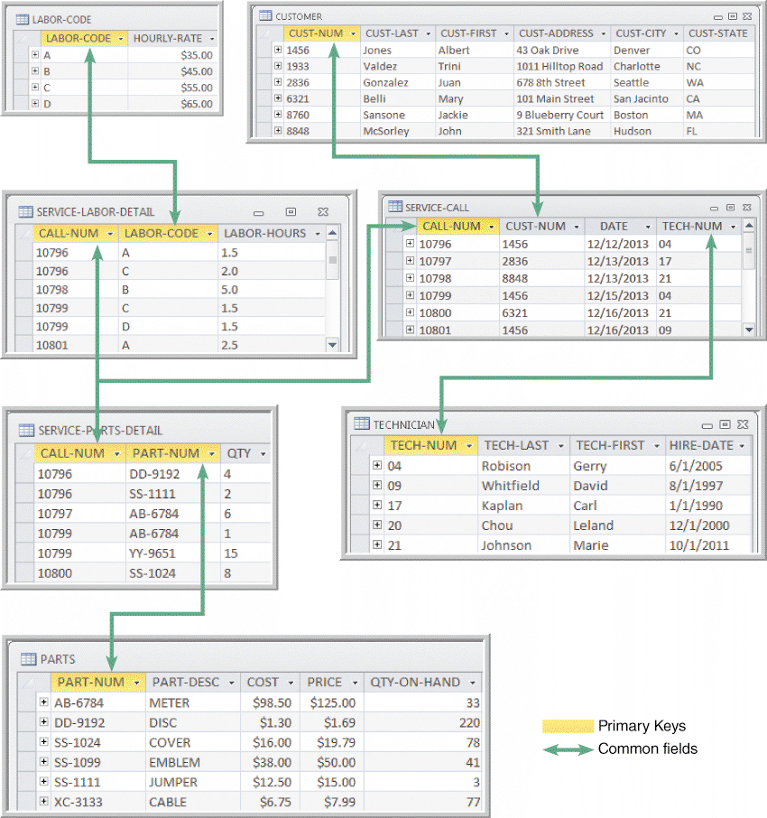
Two Real-World Examples (Cont.)
FIGURE 9-34 Sample data, primary keys, and common fields for the database shown in Figure 9-33.
The design is in 3NF. Notice that all nonkey fields functionally depend on a primary key, the whole primary key, and nothing but the primary key

Slide 45
Working with a Relational Database
Suppose you work in IT, and the sales team needs answers to three specific questions
  Did any customers receive service after 12/14/2013? If so, who were they?
  Did technician Marie Johnson put in more than six hours of labor on any service calls? If so, which ones?
  Were any parts used on service calls in Washington? If so, what were the part numbers, descriptions, and quantities?

Slide 46
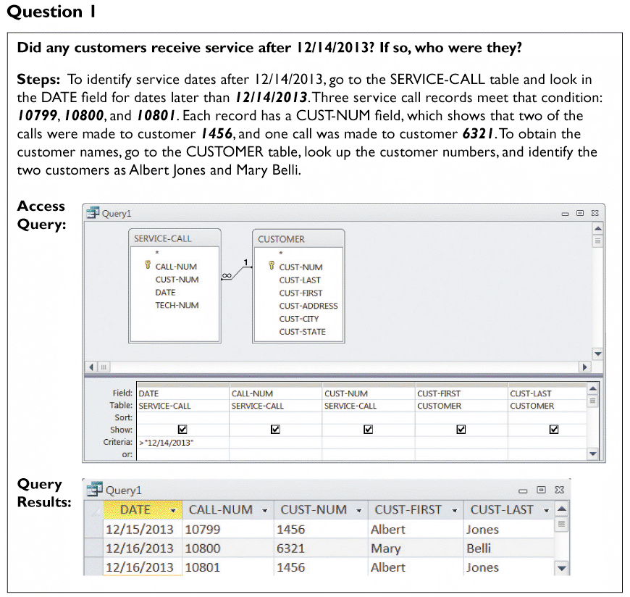
Working with a Relational Database (Cont.)
FIGURE 9-35 Question 1

Slide 47
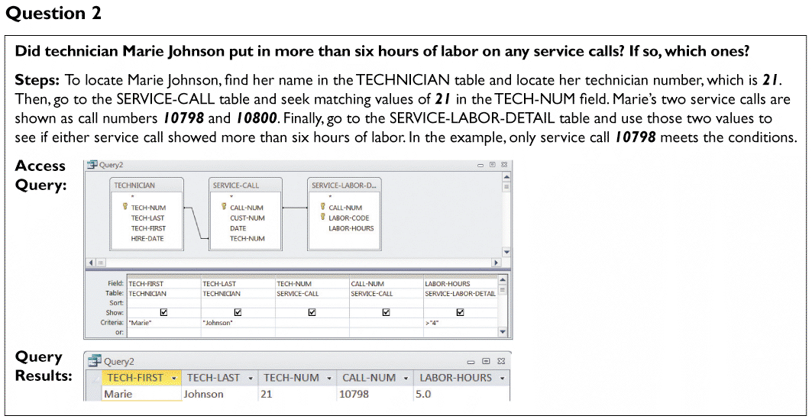
Working with a Relational Database (Cont.)
FIGURE 9-36 Question 2

Slide 48
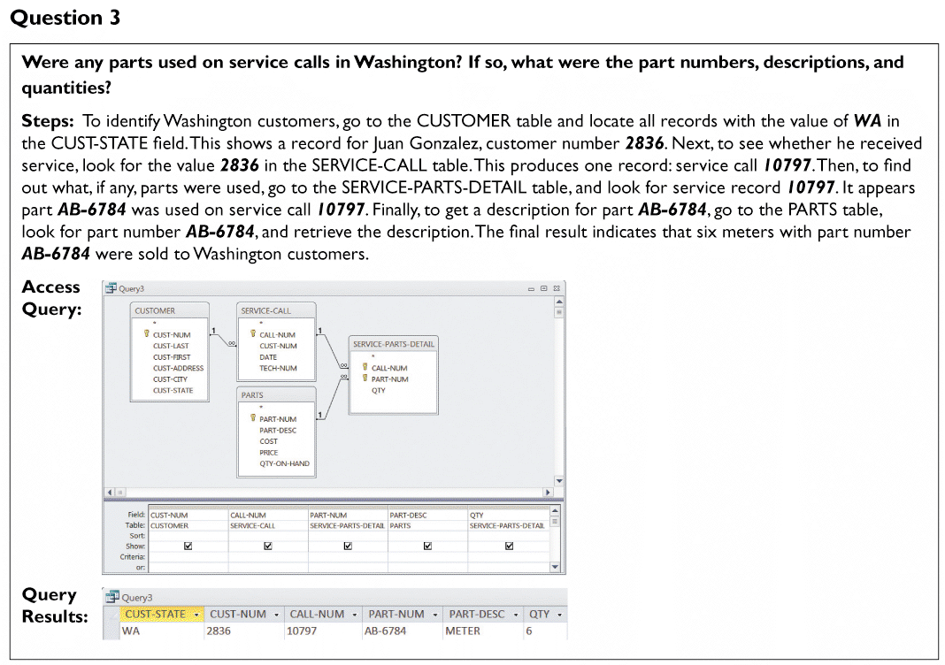
Working with a Relational Database (Cont.)
FIGURE 9-37 Question 3

Slide 49
Should You Use Codes?
Overview of Codes
  Because codes can represent data and they are shorter than the data they represent, they save storage space and costs, reduce data transmission time, and decrease data entry time
  Codes can be used to reveal or conceal information
  Codes can reduce data input errors
  Coded data is easier to remember
  The code itself can provide immediate verification that the entry is correct

Slide 50
Should You Use Codes? (Cont.)
Types of Codes
  Codes should be easy to learn and apply
  Sequence Codes
    Numbers or letters assigned in a specific order
    Contain no additional information other than an indication of order of entry into the system
      employee number 584 was hired after employee number 433
  Block sequence codes
    Use blocks of numbers for different classifications
      100-level courses are freshman-level
      200-level courses are sophomore-level

Slide 51
Should You Use Codes? (Cont.)
Types of Codes (Cont.)
  Alphabetic codes
    Use alphabet letters to distinguish one item from another
      Category codes identify a group of related items
        A department store may use a two-character category code to identify the department
        GN for gardening supplies, HW for hardware, and EL for electronics
      Abbreviation codes are alphabetic abbreviations
        State codes include NY for New York, ME for Maine, and MN for Minnesota
        Some abbreviation codes are called mnemonic codes because they use a specific combination of letters that are easy to remember as in figure 9.39

Slide 52

Should You Use Codes? (Cont.)
FIGURE 9-39 This image shows abbreviations for the world’s 30 busiest airports. How many can you identify?

Slide 53
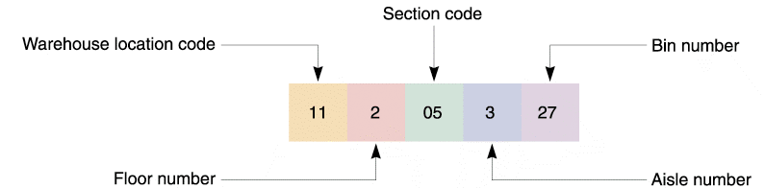
Should You Use Codes? (Cont.)
Types of Codes (Cont.)
  Significant digit codes
    Distinguish items by using a series of subgroups of digits
      Postal codes are significant digit codes
      inventory location codes that consist of a two-digit warehouse code, followed by a one-digit floor number code, a two-digit section code, a one-digit aisle number, and a two-digit bin number code.
FIGURE 9-40 Sample of a code that uses significant digits to pinpoint the location of an inventory item

Slide 54
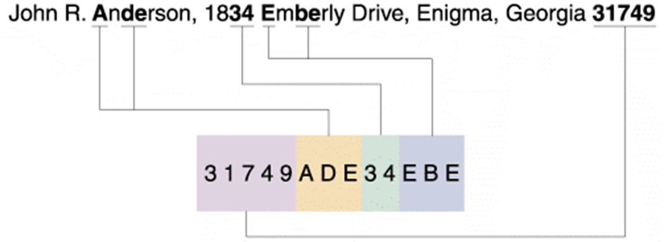
Should You Use Codes? (Cont.)
Types of Codes (Cont.)
  Derivation codes
    Combine data from different item attributes, or characteristics
    For example, one popular magazine uses a subscriber’s five-digit postal code, followed by the first, third, and fourth letters of the subscriber’s last name, the last two digits of the subscriber’s house number, and the first, third, and fourth letters of the subscriber’s street name.
FIGURE 9-41 A magazine subscriber code is derived from various parts of the name and address

Slide 55
Should You Use Codes? (Cont.)
Types of Codes (Cont.)
  Cipher codes
    Use a keyword to encode a number
      A retail store, for example, might use a 10-letter word, such as CAMPGROUND, to code wholesale prices, where the letter C represents 1, A represents 2, and so on. Thus, the code, GRAND, indicates that the store paid $562.90 for the item
  Action codes
    Indicate what action is to be taken with an associated item
      D (to display a record)
      A (to add a record),
      X (to exit the program)

Slide 56
Should You Use Codes? (Cont.)
Designing Codes
  Keep codes concise
  Allow for expansion
  Keep codes stable
  Make codes unique
  Use sortable codes
  Use a simple structure
  Avoid confusion
  Make codes meaningful
  Use a code for a single purpose
  Keep codes consistent

Slide 57
Data Storage and Access
Tools and Techniques
  Companies use data warehousing and data mining as strategic tools to help manage the huge quantities of data they need for business operations and decisions
  Data warehousing
  Data mining

Slide 58
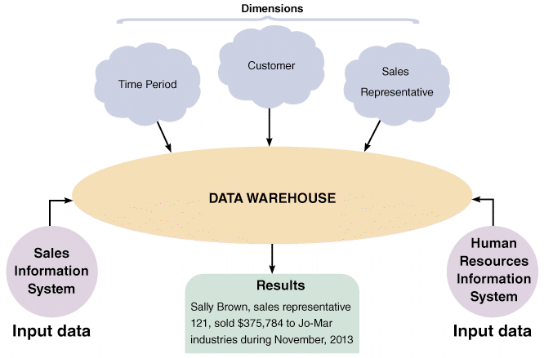
Data Storage and Access (Cont.)
Data Warehousing
  An integrated
  collection of data
  that can include
  seemingly unrelated
  information, no
  matter where it
  is stored in
  the
  company
FIGURE 9-42 A data warehouse stores data from several systems. By selecting data dimensions, a user can retrieve specific information without having to know how or where the data is stored

Slide 59
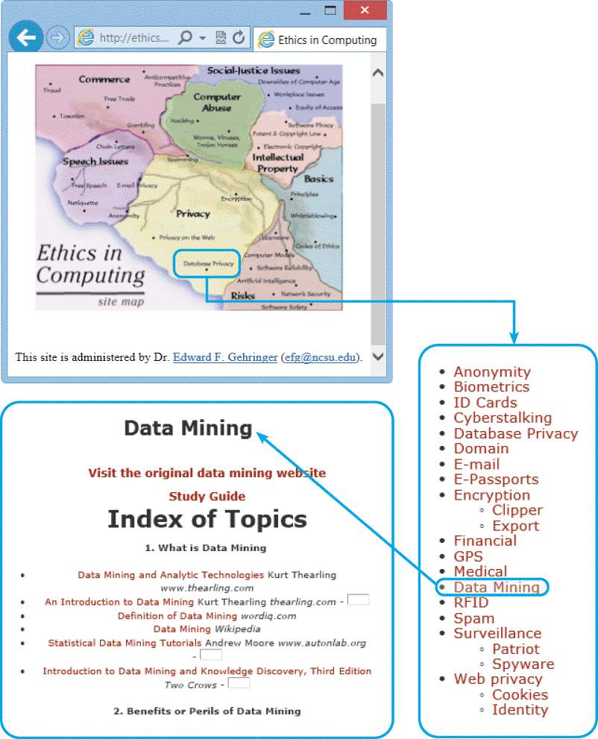
Data Storage and Access (Cont.)
Data Mining
  Looks for
  meaningful
  data patterns and
  relationships in
  large amounts
  of data
FIGURE 9-43 North Carolina State University’s clickable map can take you to a collection of IT ethics issues. Here, the map points to the data mining area

Slide 60
Data Storage and Access (Cont.)
Logical versus Physical Storage
  Logical storage refers to data that a user can view, understand, and access, regardless of how or where that information actually is organized or stored
  Physical storage is strictly hardware-related because it involves the process of reading and writing binary data to physical media such as a hard drive, CD-ROM, or network-based storage device

Slide 61
Data Storage and Access (Cont.)
Data Coding
  EBCDIC (Extended Binary Coded Decimal Interchange Code - pronounced EB-see-dik)
    A coding method used on mainframe computers and high-capacity servers
  ASCII (American Standard Code for Information Interchange - pronounced ASK-ee)
    A coding method used on most personal computers
  BINARY
    Represents numbers as actual binary values, rather than as coded numeric digits

Slide 62
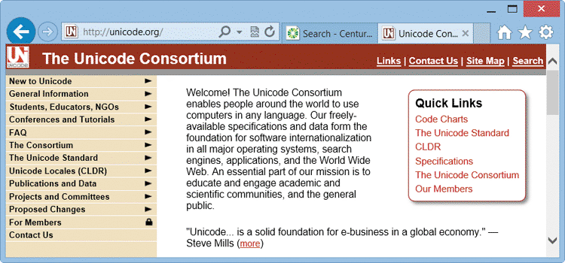
Data Storage and Access (Cont.)
Data Coding (Cont.)
  UNICODE
    Supports virtually all languages and has become a
    global standard
FIGURE 9-44 Unicode is an international coding format that represents characters as integers, using 16 bits per character. The Unicode Consortium maintains standards and support for Unicode

Slide 63
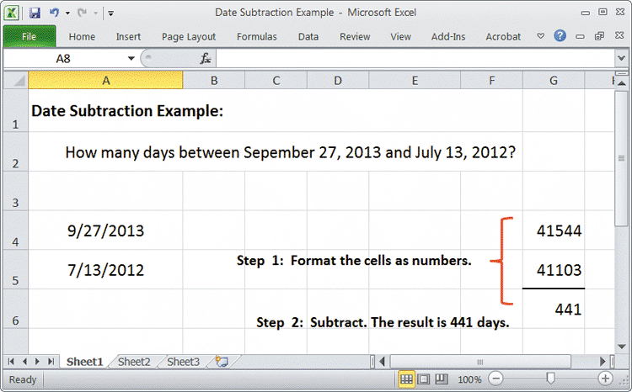
Data Storage and Access (Cont.)
Data Coding (Cont.)
  STORING DATES
    Y2K Issue
    International
    Organization for
    Standardization (ISO)
    requires a
    format of four digits
    for the year, two for
    the month, and two
    for the day
    (YYYYMMDD)
FIGURE 9-45 Microsoft Excel uses absolute dates in calculations. In this example, September 27, 2013, is displayed as 41544, and July 13, 2012, is displayed as 41103. The difference between the dates is 441 days

Slide 64
Data Control
A well-designed DBMS must provide built-in control and security features, including subschemas, passwords, encryption, audit trail files, and backup and recovery procedures to maintain data

Slide 65
Chapter Summary
A database consists of linked tables that form an overall data structure
A database management system (DBMS) is a collection of tools, features, and interfaces that enable users to add, update, manage, access, and analyze data in a database
DBMS designs are more powerful and flexible than traditional file-oriented systems

Slide 66
Chapter Summary (Cont.)
DBMS components include interfaces for users, database administrators, and related systems; a data manipulation language; a schema; and a physical data repository
In an information system, an entity is a person, place, thing, or event for which data is collected and maintained
A primary key is the field or field combination that uniquely and minimally identifies a specific record; a candidate key is any field that could serve as a primary key

Slide 67
Chapter Summary (Cont.)
An entity-relationship diagram (ERD) is a graphic representation of all system entities and the relationships among them
The relationship between two entities also is referred to as cardinality
Normalization is a process for avoiding problems in data design
Data design tasks include creating an initial ERD; assigning data elements to an entity; normalizing all table designs; and completing the data dictionary entries for files, records, and data elements

Slide 68
Chapter Summary (Cont.)
A code is a set of letters or numbers used to represent data in a system
Logical storage is information seen through a user’s eyes, regardless of how or where that information actually is organized or stored
Physical storage is hardware related and involves reading and writing binary data to physical media
File and database control measures include limiting access to the data, data encryption, backup/recovery procedures, audit-trail files, and internal audit fields

Slide 69

Chapter 6: Data Design
Next Chapter…
Chapter 7: User Interface, Input, & Output Design

